Slide 1
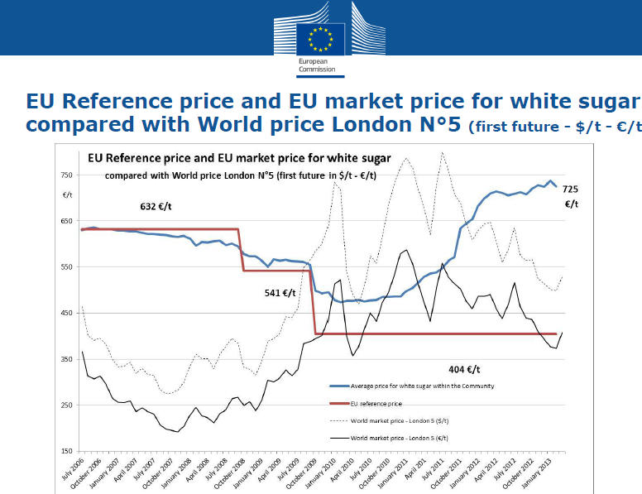
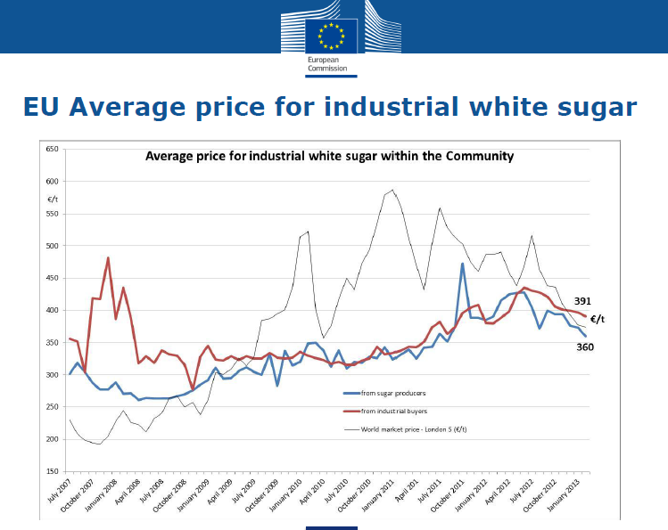
SUGAR QUOTAS SHOULD EXPIRE IN 2015
These charts show how the EU sugar quota regime fails to deliver fair competition and reasonable prices:
  Artificial sugar shortages since 2010 have pushed prices up by over 40% in spite of economies of scale and higher productivity following the restructuring of the sugar producing sector since 2006;
  The European food and drinks sector has to pay 55% more for EU sugar than competitors in third countries and buyers in the chemical, pharmaceutical and biofuels sectors.
For European SME’s in the food and drinks sector sugar quotas:
  Create unnecessary extra costs at a time when European purchasing power is falling;
  Undermine competitive positioning in growing global markets, thus holding back expansion of manufacturing and exports from the EU and leaving others to take market share at a time when Europe needs jobs and growth
Average price paid by buyers from the EU food and drinks sector who have to buy quota sugar
Average price paid by chemical, pharma, biofuel and 3rd country food buyers, who can buy out of quota sugar

